Slide 1


Dependency Management
Speaker:
Igor

Slide 2

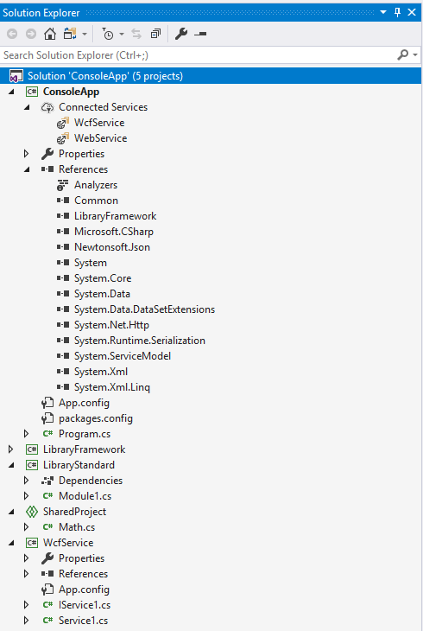
Solution
Solution is simply a container for one or more related projects, along with build information and Visual Studio window settings.

Slide 3
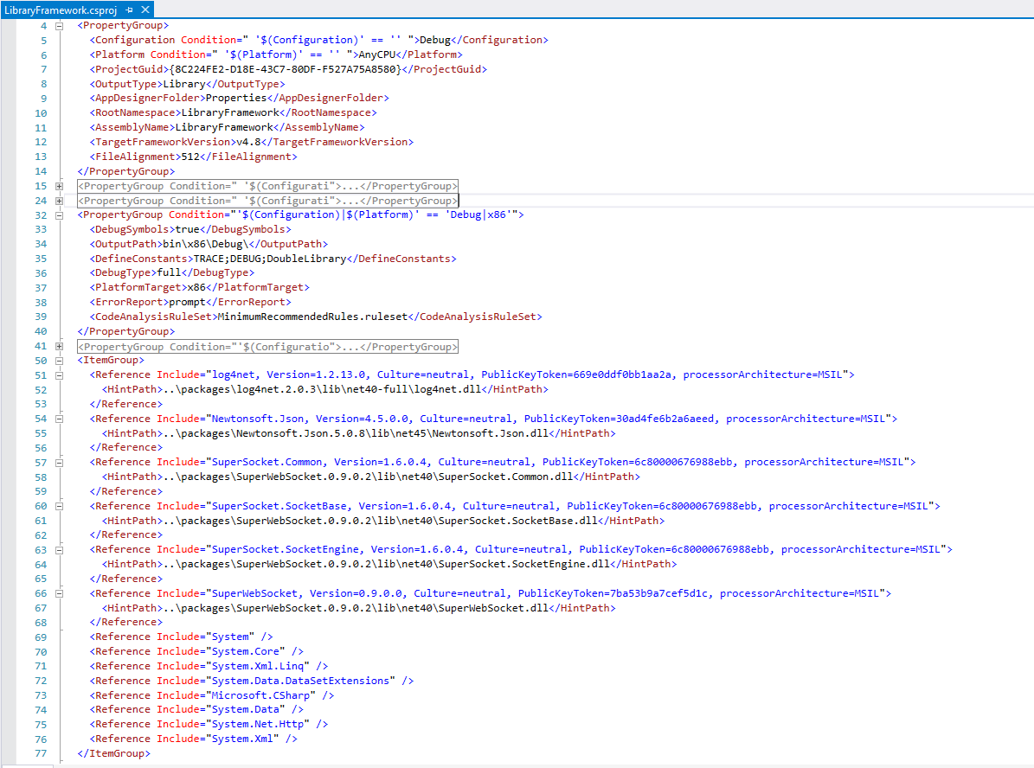

Project
In a logical sense, a project contains all the source code files, icons, images, data files, etc. that are compiled into an executable, library, or website. A project is defined in an XML file with an extension such as .vbproj, .csproj, or .vcxproj. This file contains a virtual folder hierarchy, and paths to all the items in the project. It also contains the build settings.
When you compile your project, the MSBuild engine consumes the project file to create the executable.

Slide 4
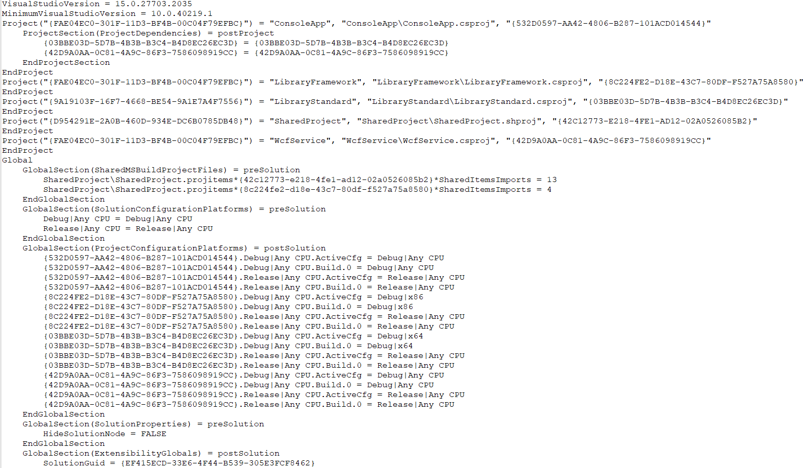
Visual Studio uses two file types to store settings for solutions:
.sln - Visual Studio Solution.
Organizes projects, project items, and solution items in the solution.
.suo - Solution User Options.
Stores user-level settings and customizations, such as breakpoints.

Slide 5
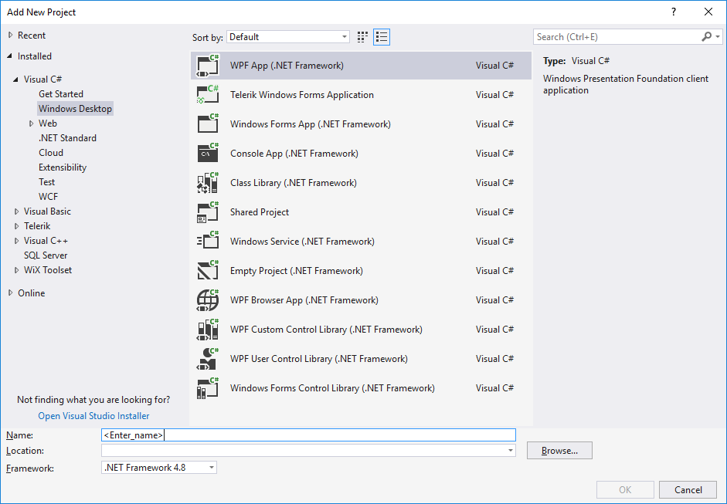
v
Create new projects
The easiest way to create a new project is to start from a project template for a particular type of application or website. A project template consists of a basic set of pre-generated code files, config files, assets, and settings.

Slide 6
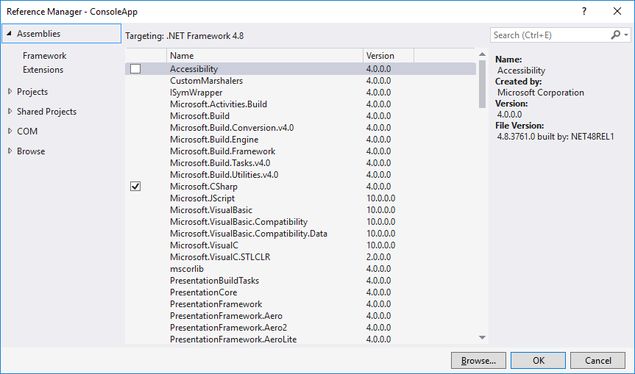
Reference Manager
Reference Manager allows to add and manage references to components that you, Microsoft, or another company developed.
Assemblies
Projects
Shared project
Com
Browse

Slide 7

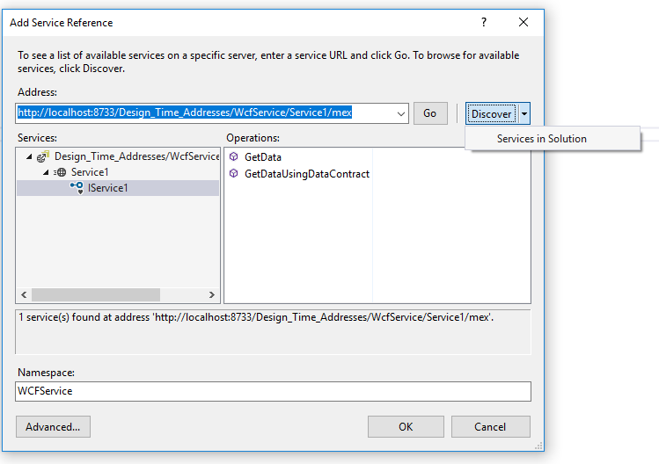
Add Service Reference Tool
This tool retrieves metadata from a web service in the current solution, on a network location, or from a WSDL file, and generates a .NET Core compatible source file containing Windows Communication Foundation (WCF) client proxy code that you can use to access the web service.

Slide 8
Circular references
Library A
Library C
Library B

Slide 9
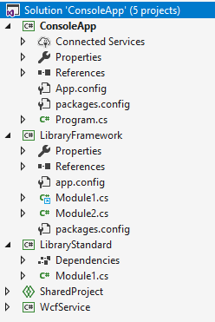
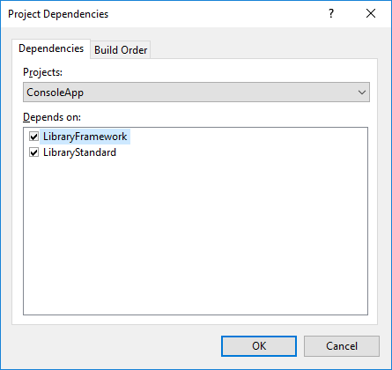
Project Dependencies
When building a solution that contains multiple projects, it can be necessary to build certain projects first, to generate code used by other projects. When a project consumes executable code generated by another project, the project that generates the code is referred to as a project dependency of the project that consumes the code. Such dependency relationships can be defined in the Project Dependencies dialog box.

Slide 10
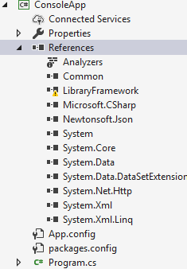
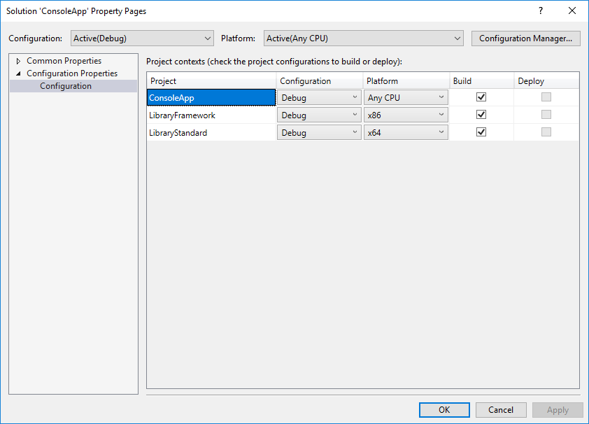
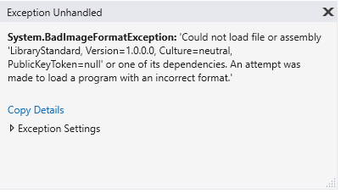
Common Mistakes

Slide 11
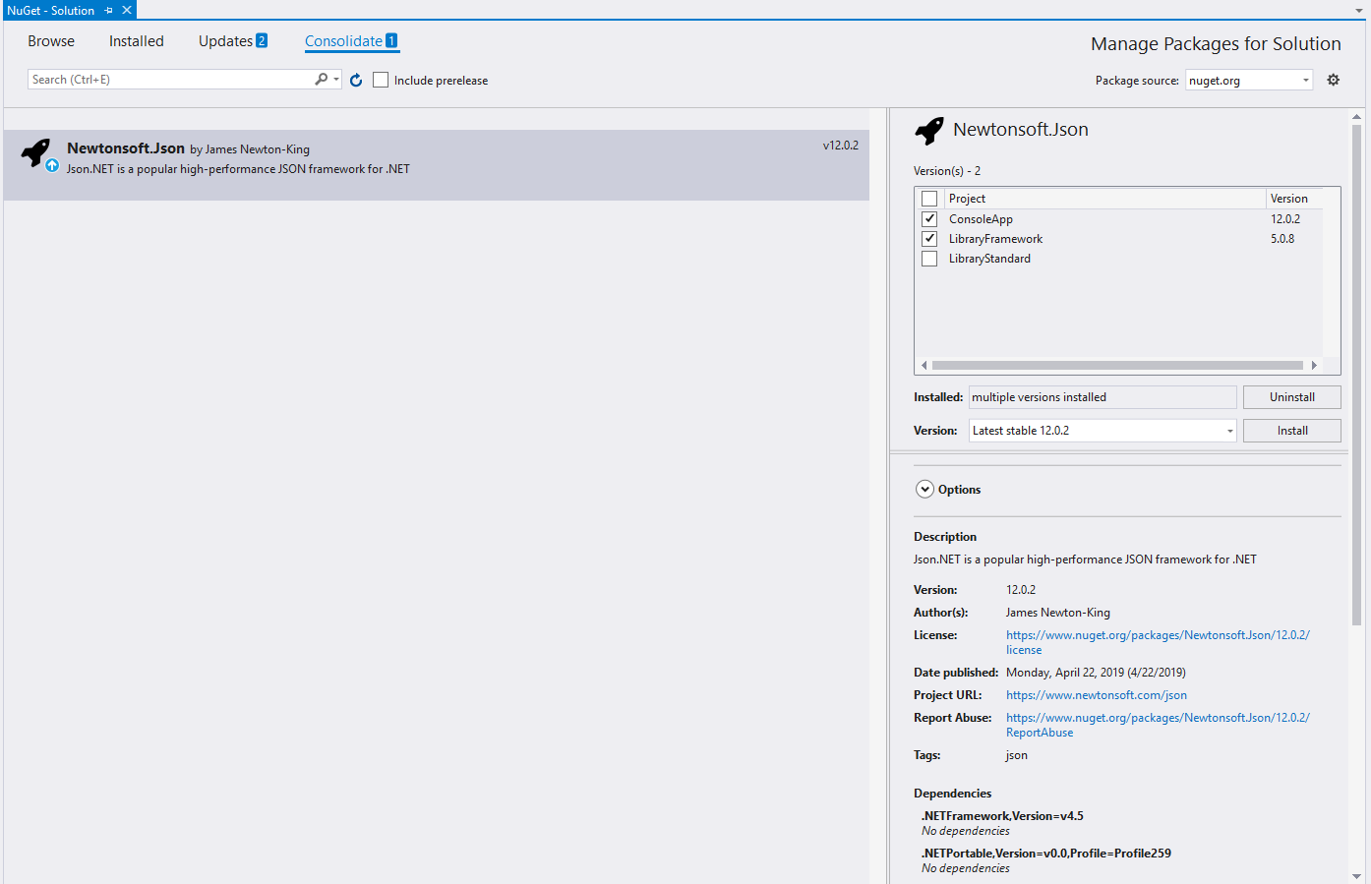
Package Manager
The primary way of adding dependencies to a .NET library is referencing NuGet packages. NuGet package references allow you to quickly reuse and leverage already written functionality, but they're a common source of friction for .NET developers.

Slide 12
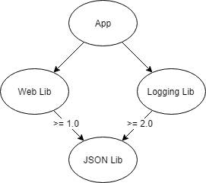
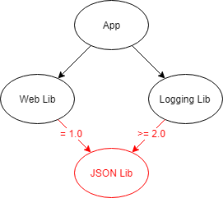
It's a common situation for a .NET project to have multiple versions of a package in its dependency tree. For example, an app depends on two NuGet packages, each of which depends on different versions of the same package.
DO review your .NET library for unnecessary dependencies.
DO NOT have NuGet package references with no minimum version.
AVOID NuGet package references that demand an exact version.
AVOID NuGet package references with a version upper limit.
NuGet always looks for the lowest applicable version. NuGet prefers the lowest applicable version over using the highest available because the lowest will have the least compatibility issues.

Slide 13
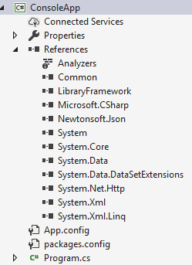
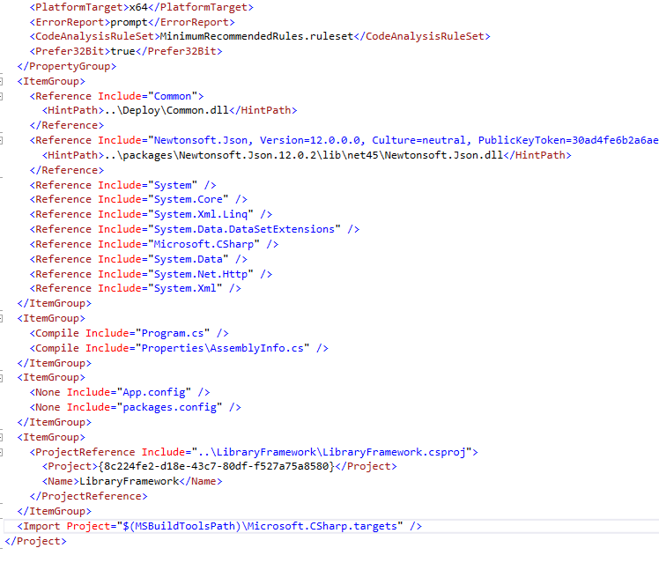
References

Slide 14
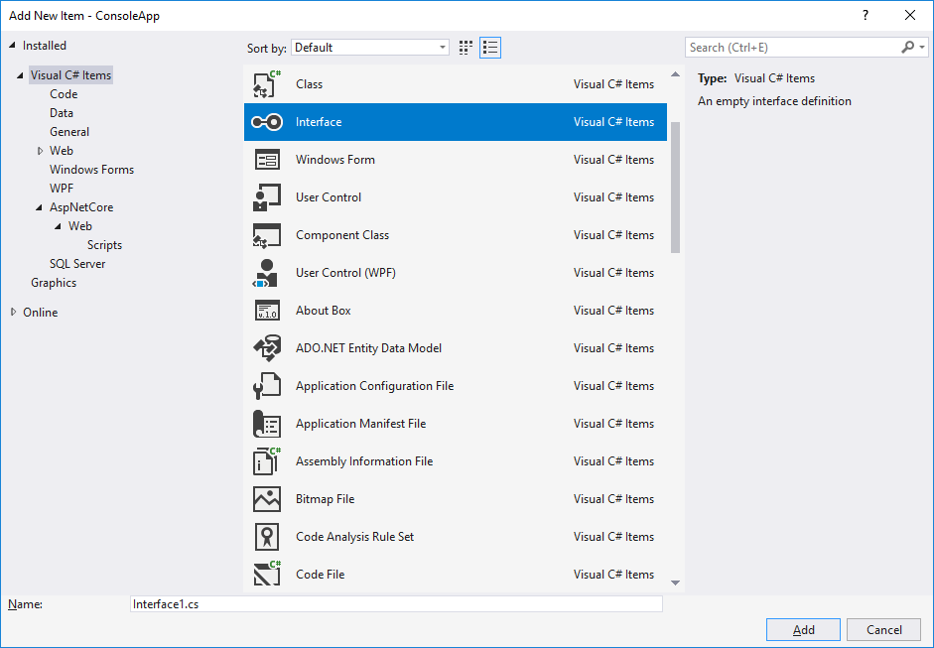
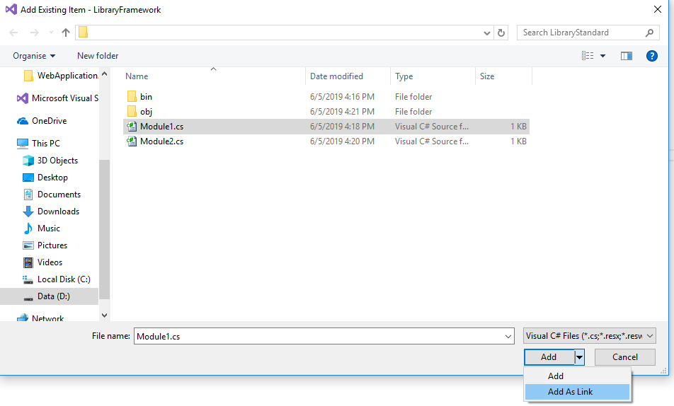
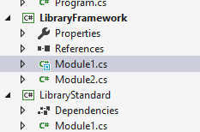
Add New Item

Slide 15
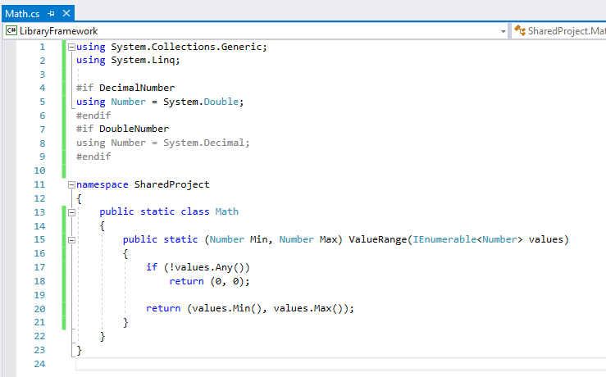
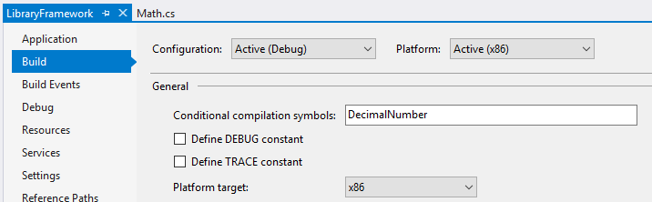
Shared Project

Slide 16

Thank you!

